Slide 1
Content aware image resizing and object removal using seam carving
By
Rahul Kumar Dev(18108)
Saurav Kumar Sharma(17882)

Slide 2
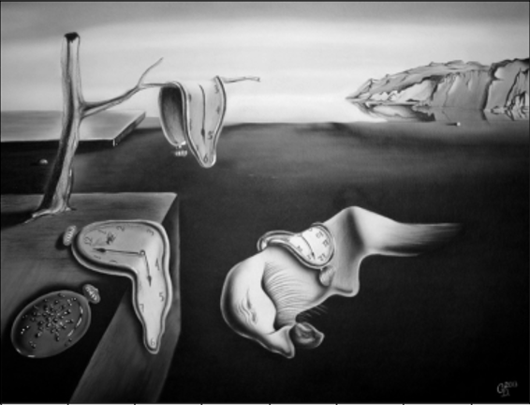
Problem Statement:-
To resize an image , we can use cropping, or scaling(distortions) . Both these methods remove essential
information from the image. We intend to do resizing of an image without loosing information of
ROI(Region of interest) using seam carving.
There is lot of empty region in this image which are not of interest. We want to preserve
the ROI in this image without distorting them or removing them partially.
Cropped Region
Downscaling with distortions
And we also want to extend idea of seam carving to object removal.

Slide 3
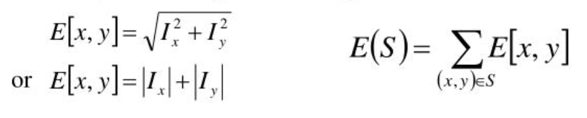
Methodologies:-
Performing Edge Detection
Each Pixel importance is given by gradient magnitude, So smooth region are of less
Importance and so have less pixel importance:-

Slide 4
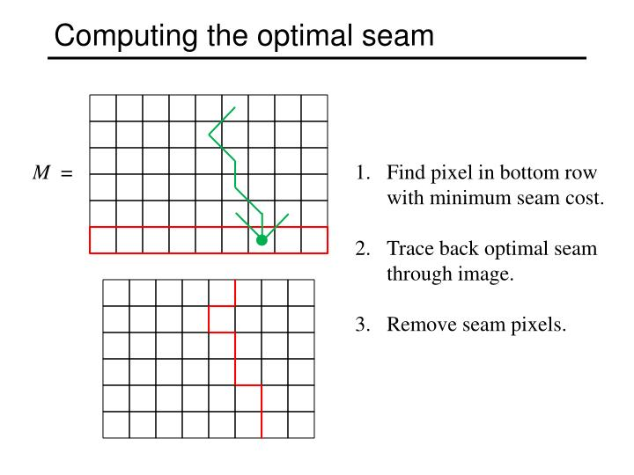
Finding Seam:-
Seam :- The path of connected pixels which has minimum cost.
We will use DP(Dynamic Programming) for finding the seam with minimum cost.
In Seam image, Bright region are ROI(Region of Interest) .
Thus, they have high cost So, seam would avoid passing through them.
Seam

Slide 5
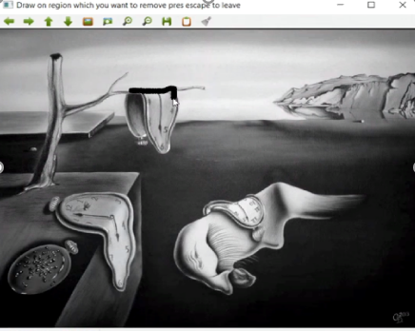
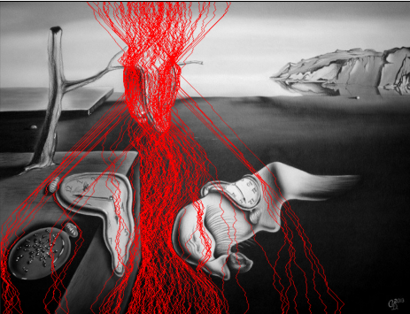
Object Removal:-
This concept was extended to remove an object from the image.
User can select the region which they want to remove.
Then by decreasing the importance of each pixels in the selected patch, we made seams to pass through the
selected patch of region which user want to remove.

Slide 6
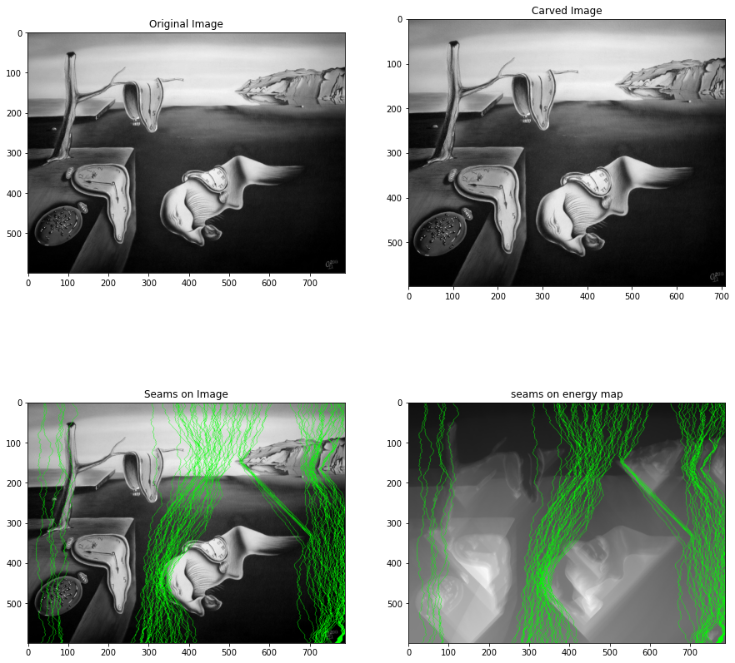
Results:-
Scaling Factor 0.9
80 seams to be
removed

Slide 7
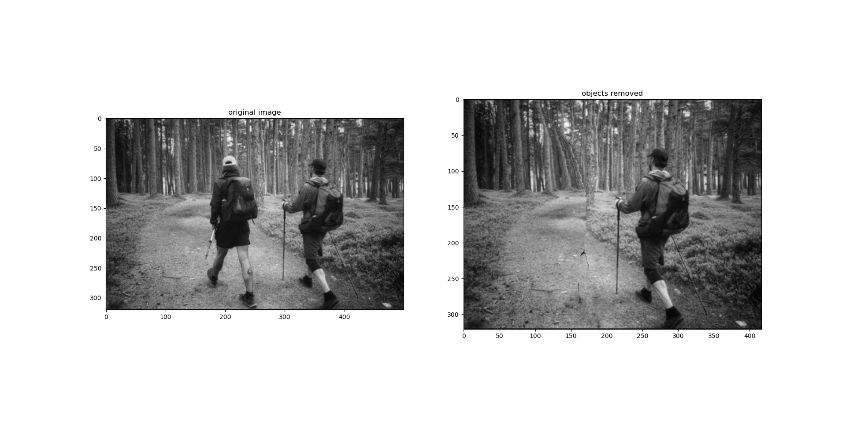
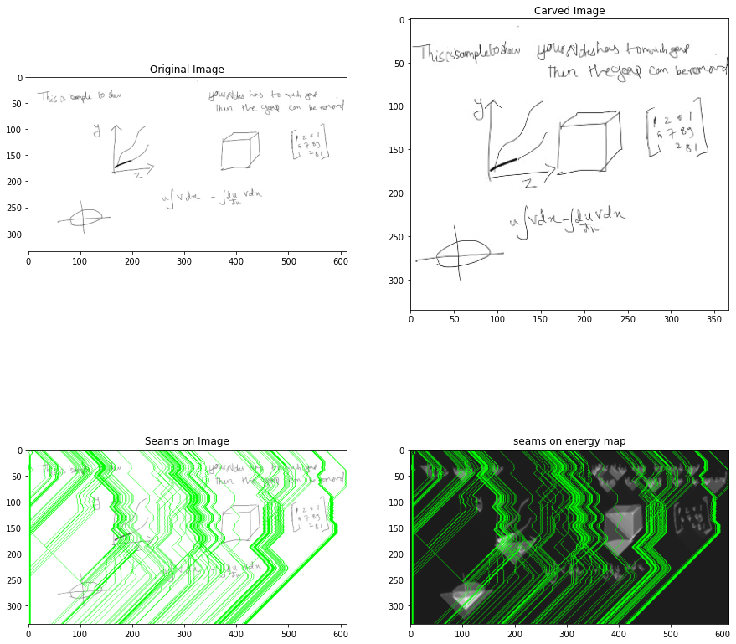
Results:-
Red Region removed

Slide 8
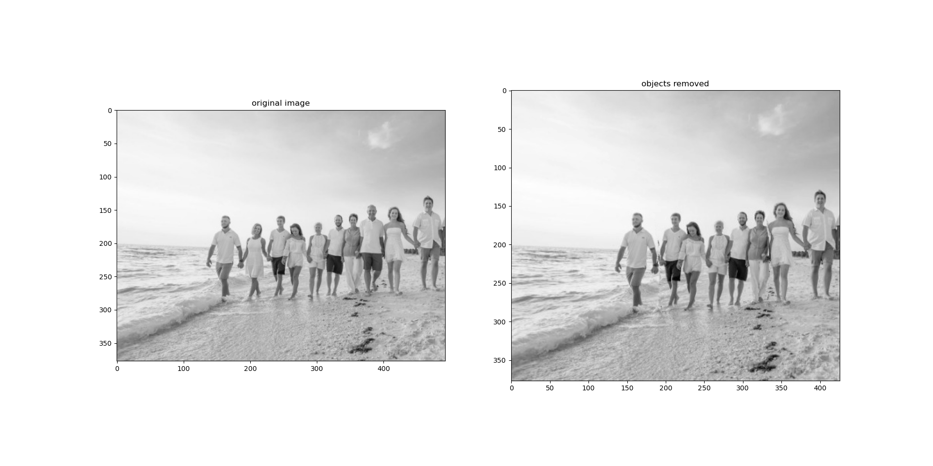
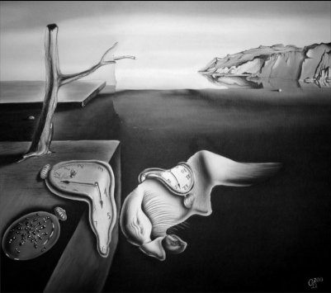
Results:-
Regions to remove

Slide 9
Limitations:-
In this image, the object of interest was the monolith and it gets removed while resizing using seam carving.
This method looks for smooth region to remove. So in cases where ROI(region of interest) is smooth and
when background has texture then this process fails to recognize the region of interest.

Slide 10
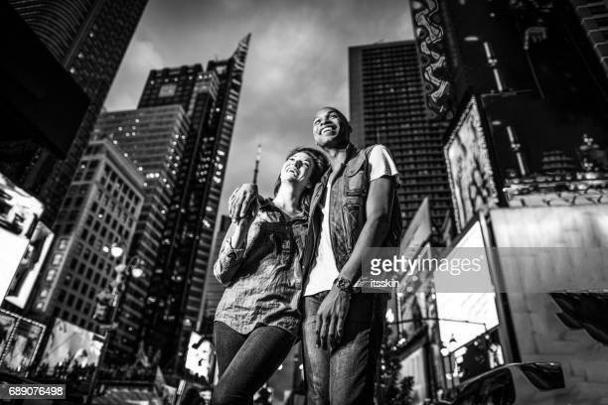
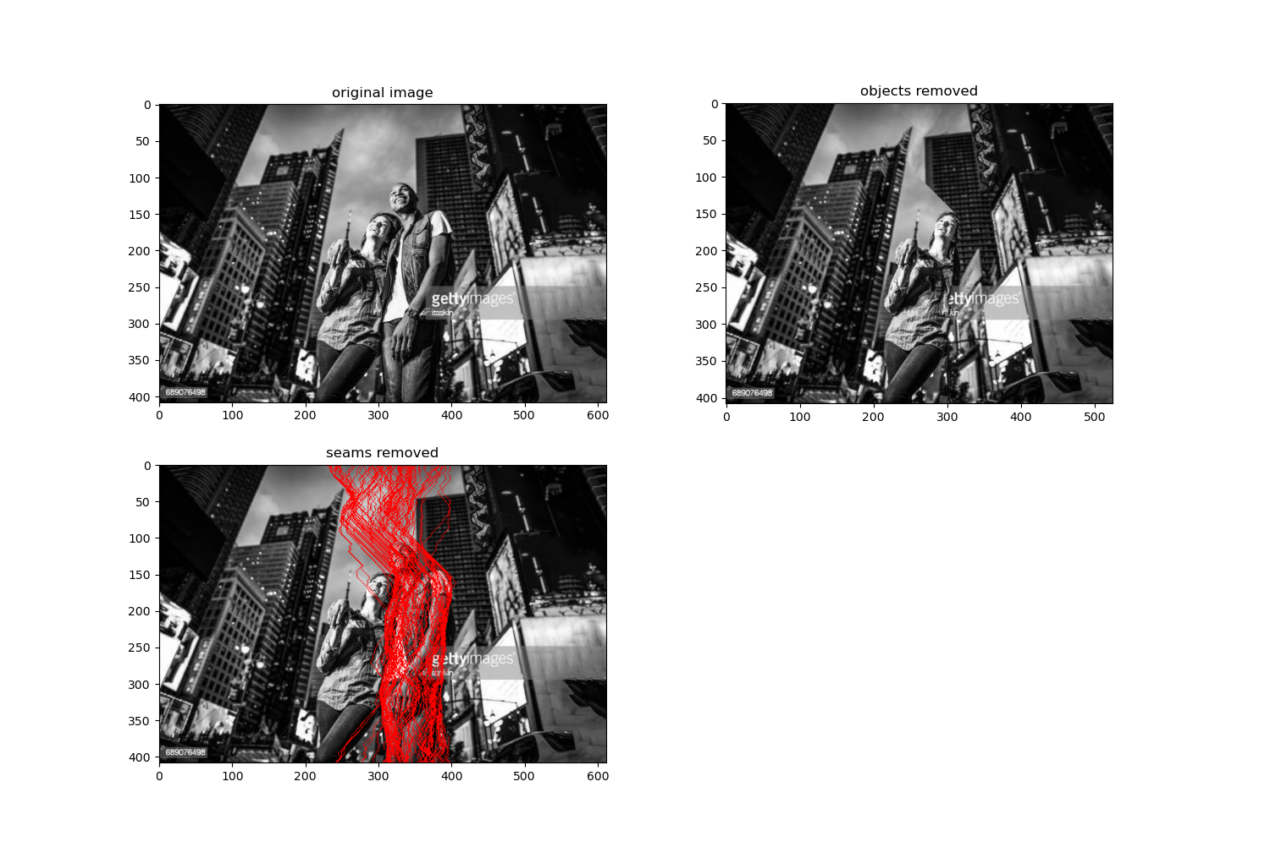
Limitations:-
When the background of object to be removed
has geometric shape then the removal seams are
visible.

Slide 11
References:-
https://en.wikipedia.org/wiki/Seam_carving
https://perso.crans.org/frenoy/matlab2012/seamcarving.pdf

